Slide 1

Adaptive Determination of the Intended Use Population

Slide 2
Old View
Broad eligibility
  Fear that an approved drug might not work in widespread community practice
Assumption that disease is homogeneous and that treatment benefits all patients similarly

Slide 3
New Paradigm in Oncology Clinical Trials
New century - recurrent somatic mutations in tumors were discovered
  50% of melanoma tumors contained the same point mutation in the BRAF gene
Tumors of the same primary site can represent different diseases, with sensitivity to different treatments.
This changed the approach to discovery and clinical evaluation of new treatments.

Slide 4
Number of Oncology Drugs/Indications Approved by FDA
2000 – 2005 35 drugs
2011 – 2016 85 drugs

Slide 5
The Most Important Decisions in Developing a Phase III Clinical Trial
Whether to do a phase III trial
What patient population

Slide 6
The Most Important Decisions in Developing a Phase III Clinical Trial

Slide 7
The Most Important Decisions in Developing a Phase III Clinical Trial
Whether to do a phase III trial
What patient population

Slide 8

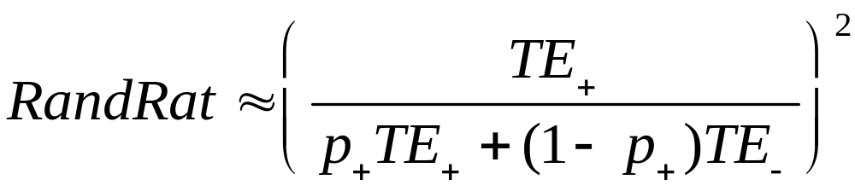
TE₊=rx effect in marker + stratum
TE₋= rx effect in marker – stratum
p₊=proportion of patients marker +

Slide 9

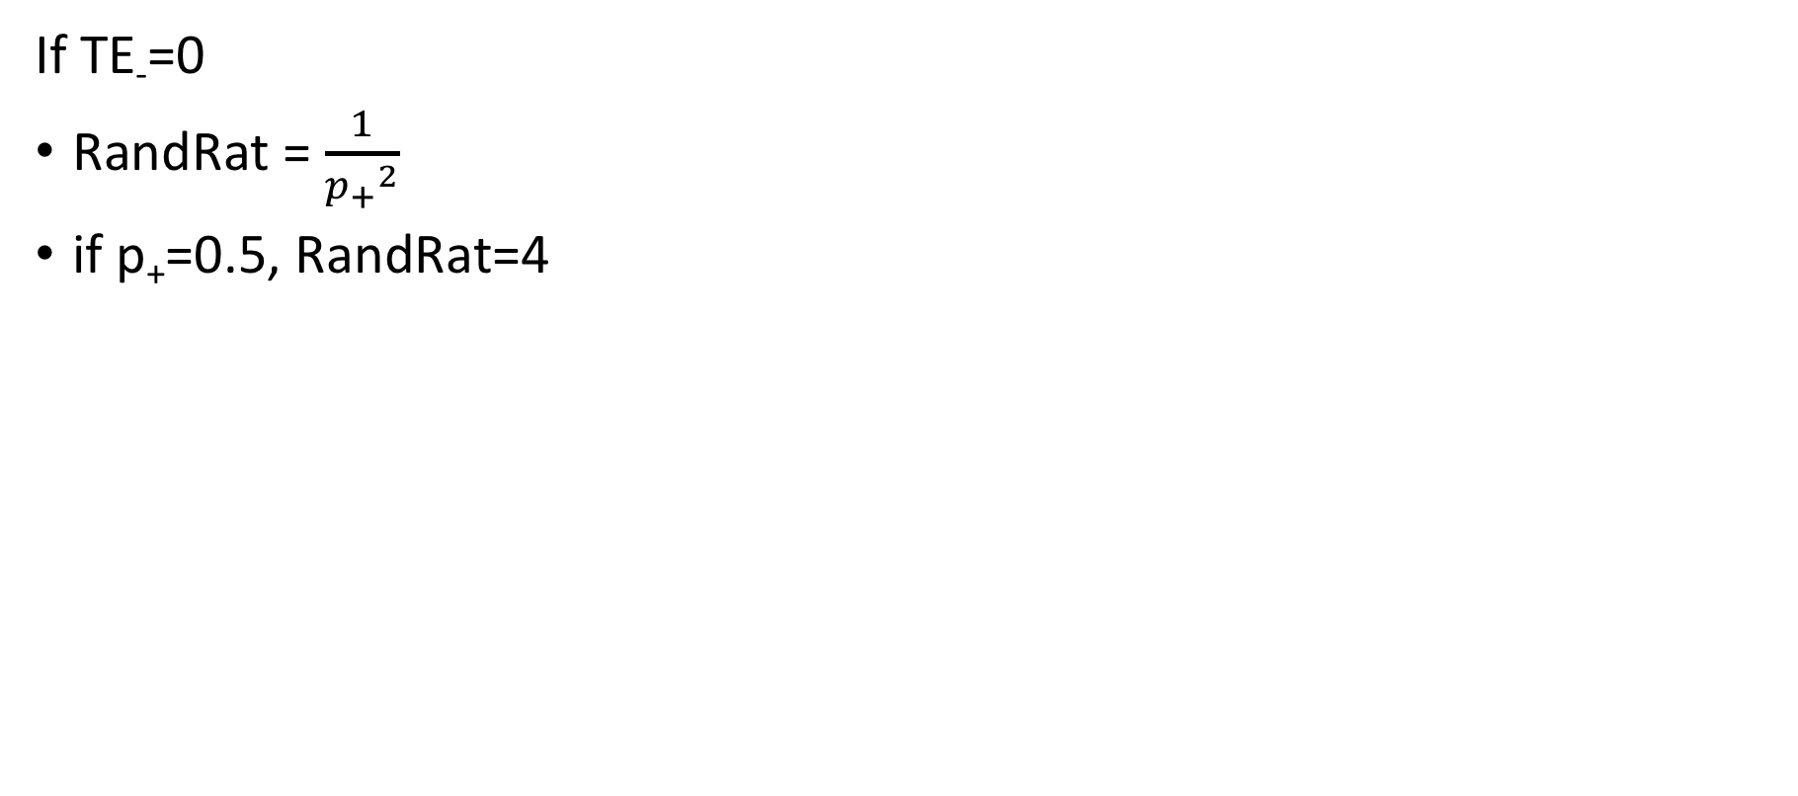

Slide 10

Comparing E vs C on Survival or DFS
5% 2-sided Significance and 90% Power
% Reduction in Hazard | Number of Events Required
25% | 509
30% | 332
35% | 227
40% | 162
45% | 118
50% | 88

Slide 11
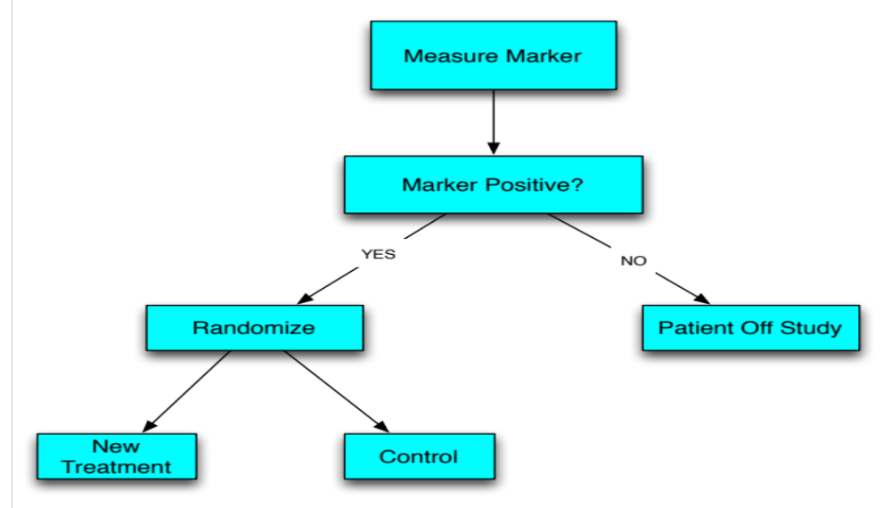
Enrichment Design

Slide 12
Large randomized phase II trials can take a long time

Slide 13
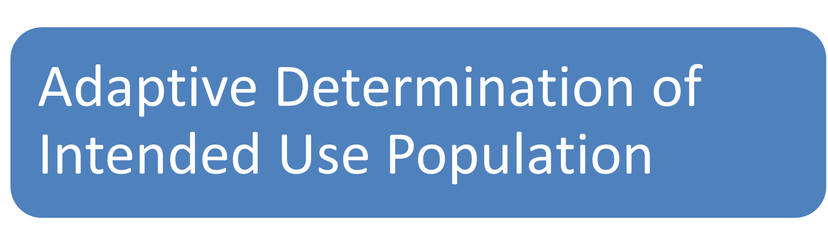

Slide 14
Randomized population is only used as intended use population to avoid issues of subset analysis
The proportion of patients in the randomized population who benefit from the test treatment in “positive” clinical trials is very small

Slide 15
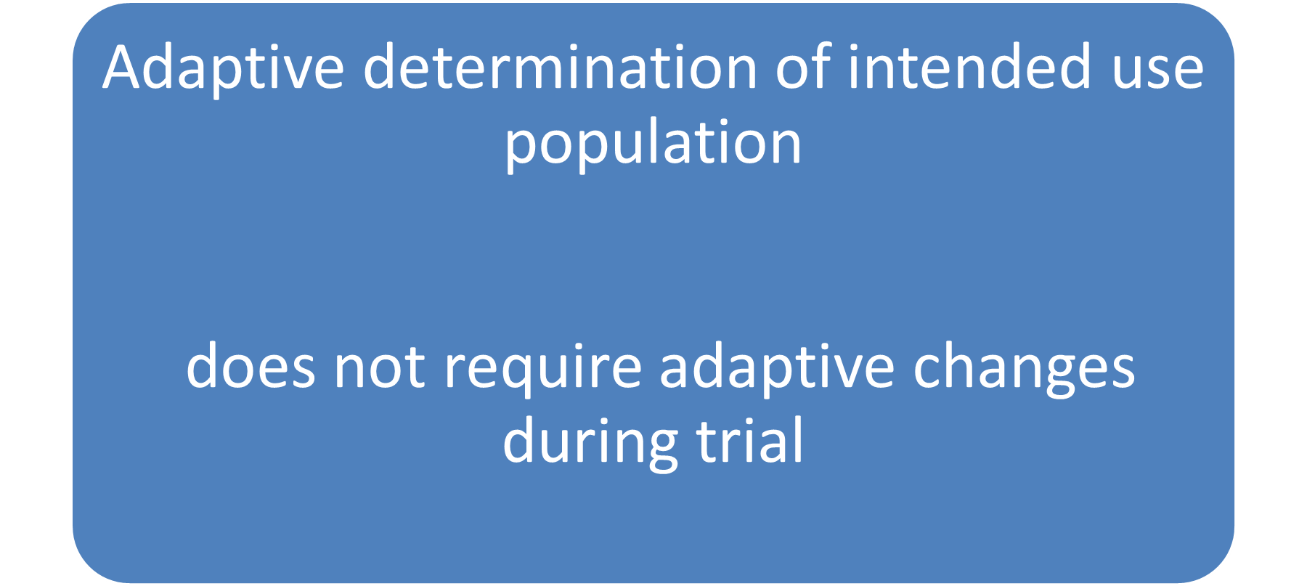

Slide 16
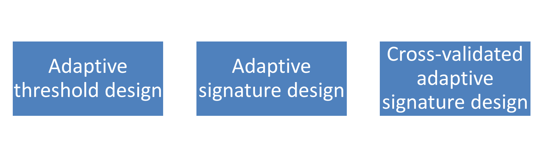

Slide 17
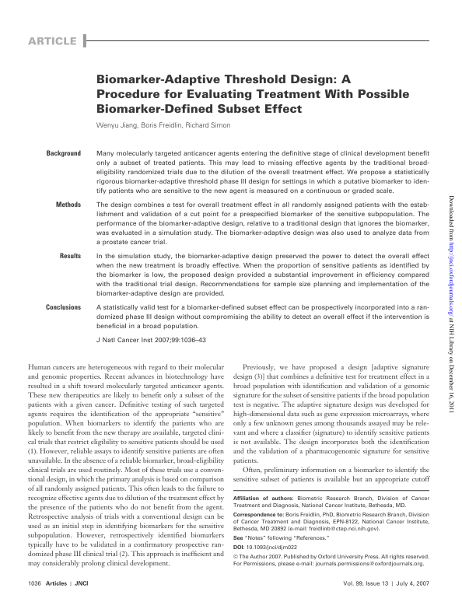

Slide 18
Adaptive Threshold Design
Randomized clinical trial of E vs C
Single candidate biomarker B with K candidate cut-points b₁, …, b_{K}
  in [0,1]
  e.g. b₁=0, b₂=0.25 & b₃=0.5
Entry not restricted by biomarker value

Slide 19
Final Analysis
Test H_{k} for k=0,1,…,K.
  H_{k} : treatment effect is 0 for population with B≥b_{k}
  Compute p_{k} for treatment effect for each population with B≥b_{k}
Use p* = min {p_{k}} as global test statistic.
Test significance of p* using a permutation test.
If global null hypothesis was rejected, model treatment effect as a function of biomarker value
  Compute bootstrap confidence intervals for the optimal cut-point

Slide 20
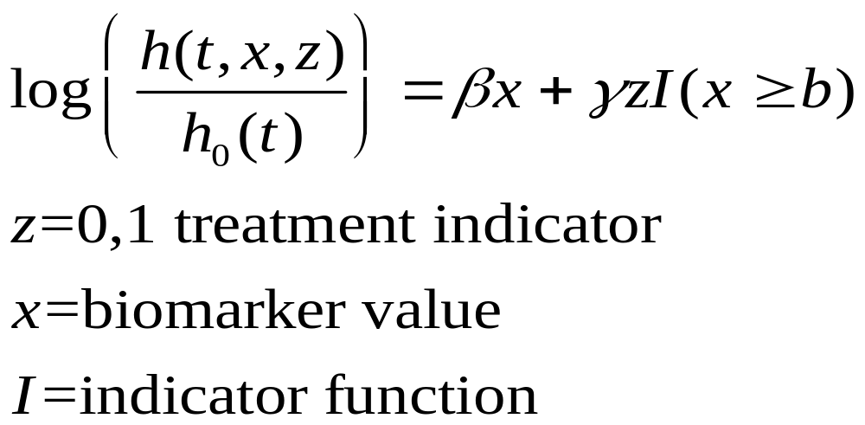
Threshold Model for Survival Data

Slide 21
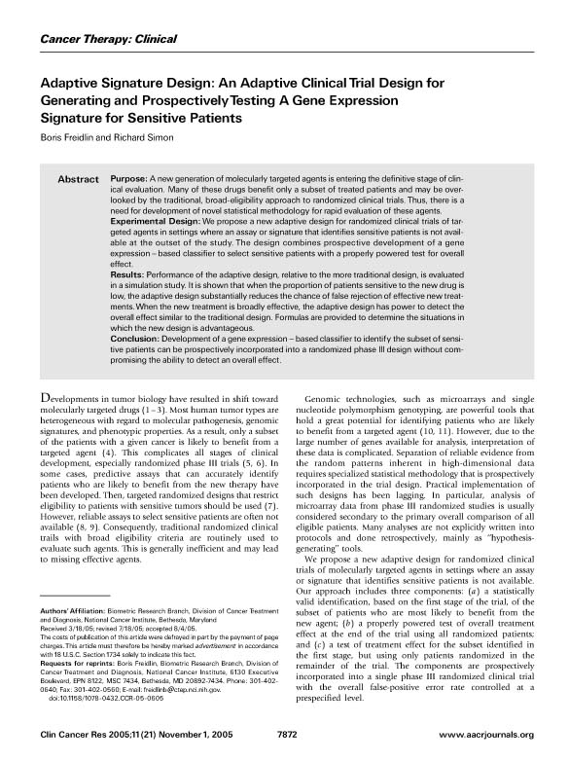

Slide 22
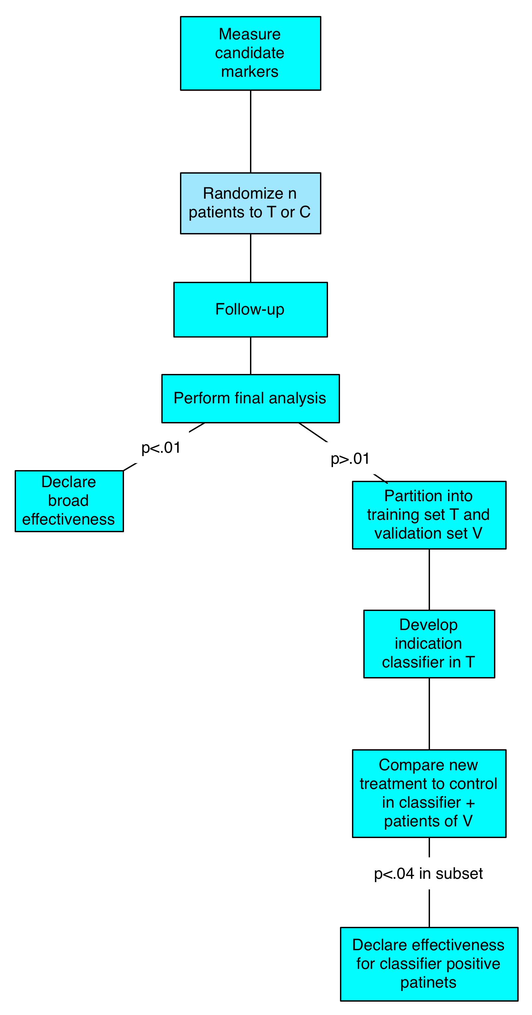
Adaptive Siganture Design
Discover & Validate Predictive Signature

Slide 23
What is a Predictive Classifier?

Slide 24
Predictive Classifier
A predictive classifier is not a prognostic classifier
It is a binary classifier of whether the prognosis of a patient on E is better than the prognosis of the patient on C

Slide 25
X vector ➔ {E,C}

Slide 26
Predictive Classifier
The predictive classifier may be based on separate prognostic classifiers for patients on E and for patients on C
  P(x|C) probability of response to rx C for patient with covariate vector x
  P(x|E) probability of response to rx E for patient with covariate vector x
  Predictive Classifier(x) = E if P(x|E) > P(x|C) + ε
  = C otherwise

Slide 27
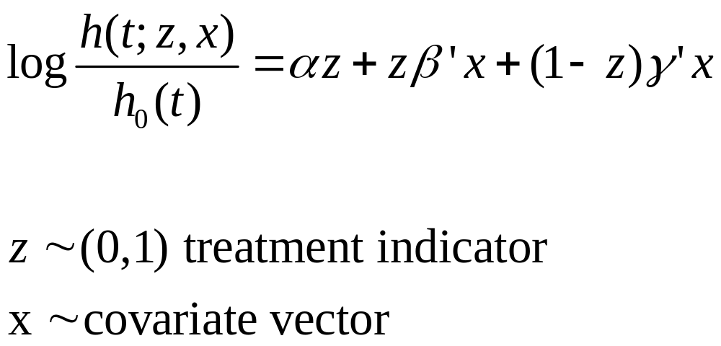
Fit (penalized) PH model

Slide 28
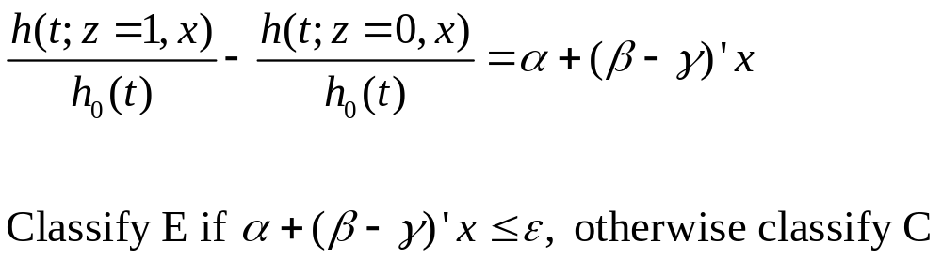

Slide 29
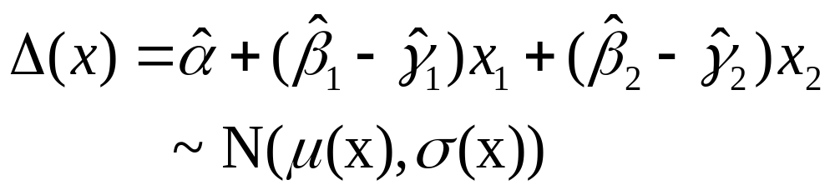
Example
At interim analysis determine the mle’s of the regression coefficients and their estimated covariance matrix
Compute approximate mean and variance of

Slide 30
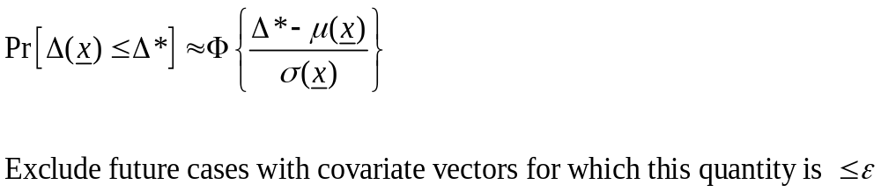

Slide 31
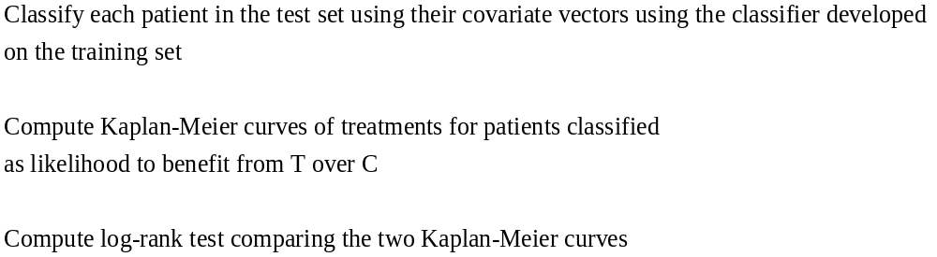
Evaluation of Predictive Classifier on Separate Test Set

Slide 32
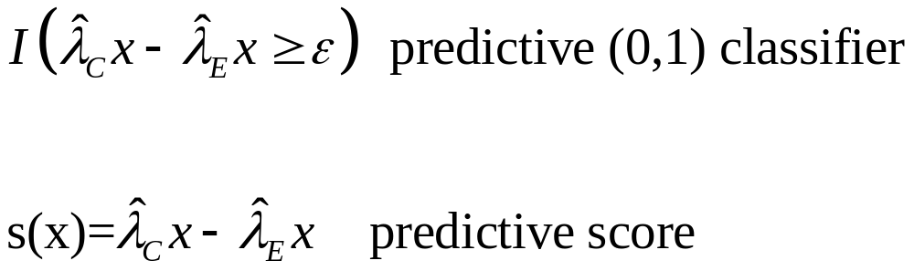
Generalization of predictive classifier to predictive score

Slide 33
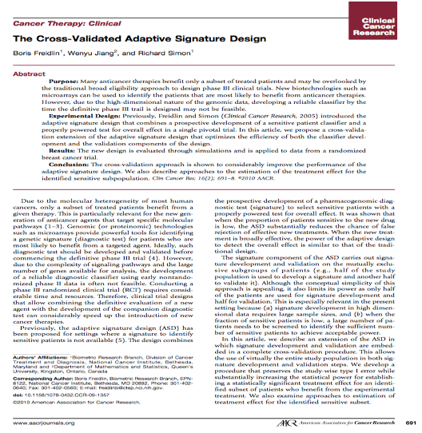

Slide 34
Cross-Validated Adaptive Signature Design
Define predictive classifier development algorithm A
Apply algorithm to full dataset D to develop predictive classifier M(x;D,A) for use with future cases
How to evaluate the performance of this classifier?
  How to avoid the bias of “re-substitution” since there is no separate test set?

Slide 35
Pre-validation solution
Construct a “pre-validated” test set
The pre-validated test set will contain all of the cases with their covariate vectors, treatment indicators and outcomes
The synthesized predictive score for case i is s_{i}’= M(x_{i} ; D^{-i} ,A).

Slide 36
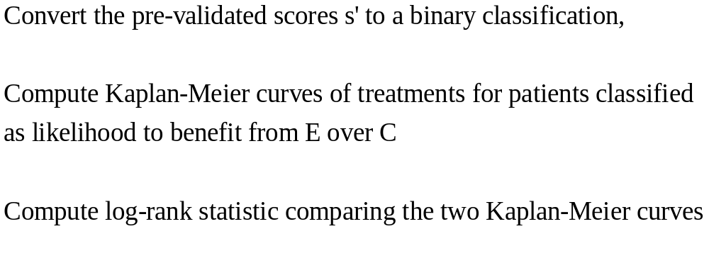

Slide 37
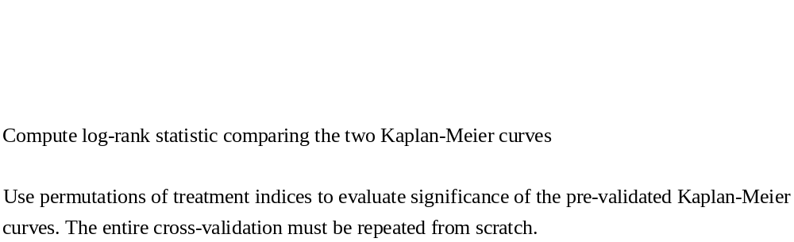

Slide 38
Key Ideas
Replace multiple significance testing by development of one predictive classifier
Internal validation by computing significance of treatment effect in adaptively determined intended use population
Obtain almost unbiased estimate of the treatment effect of future classifier positive patients

Slide 39
Pre-trial planning for Adaptive Signature or Adaptive Threshold Design
Analysis plan should be in protocol
Analysis plan should specify candidate covariates and threshold cut-offs

Slide 40
Measures of predictive performance for survival data
Spread of KM curves of the two treatment groups for the subset of patients classified as likely to benefit from T over C.
  Log-rank statistic
  Hazard ratio
Area under time-dependent ROC curve for adaptively determined subset
Simon’s sensitivity, specificity, npv, ppv for binary predictive covariates and survival data

Slide 41
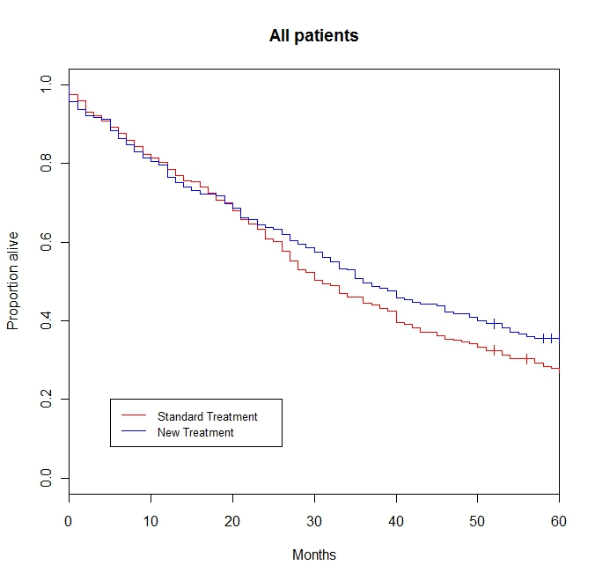
Figure 1: Overall analysis. The value of the log-rank statistic is 2.9 and the corresponding p-value is 0.09. The new treatment thus shows no benefit overall at the 0.05 level.

Slide 42
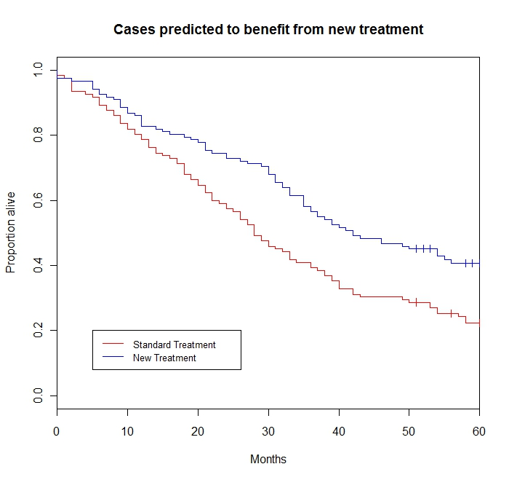
Figure 2: Cross-validated survival curves for patients predicted to benefit from the new treatment. log-rank statistic = 10.0, permutation p-value is .002

Slide 43
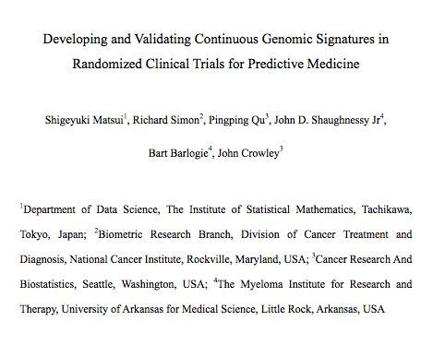

Slide 44
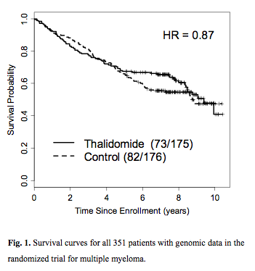

Slide 45
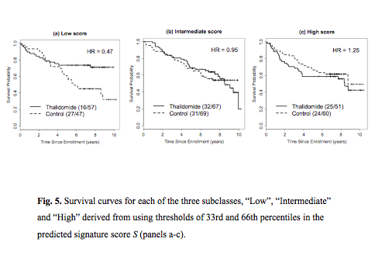

Slide 46
Cross-Validated Adaptive Signature Design
Evaluation using Bootstrap Instead of
Pre-validation
Re-sample bootstrap training set D’
  Develop classifier M(;D’,A)
  Classify out-of-box cases using M(;D’,A)
  Let S denote the out-of-box cases classified as likely to benefit from E over C
    Compute hazard ratio for KM curves of treatment groups in S

Slide 47
Cross-Validated Adaptive Signature Design
Evaluation using Bootstrap Instead of
Pre-validation
Classify cases in D’ using M(;D’,A)
  Let S’ denote the cases in the bootstrap sample D’ classified as likely to benefit from E over C
    Compute hazard ratio for KM curves of treatment groups in S’
  Hazard ratio in S minus hazard ratio in S’ is an estimate of re-substitution bias in hazard ratio

Slide 48
Cross-Validated Adaptive Signature Design
Bootstrap De-diasing of Resubstitution Estimate
  Repeat for many bootstrap samples and average the bias estimates
  Correct the re-substitution estimate of hr for the full sample D by adding on average bias

Slide 50
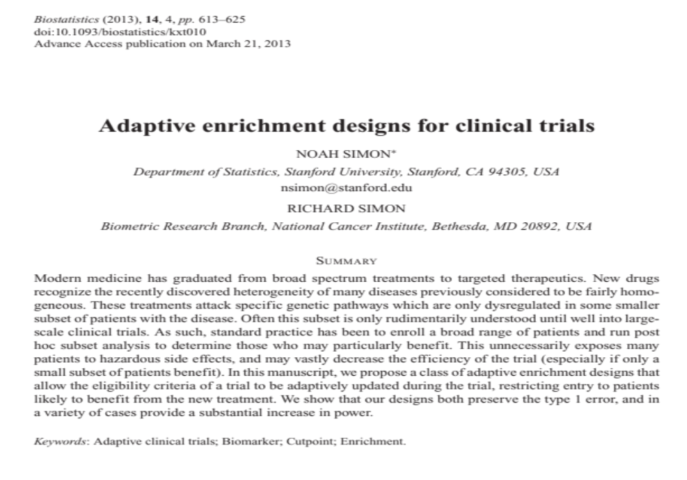

Slide 51
Adaptive Enrichment Designs
Includes one or more interim analyses that may modify eligibility criteria based on candidate covariates
Single significance test at final analysis
All patients included in final analysis

Slide 52
Adaptive Enrichment Designs
Single binary covariate
Quantitative covariate
Multiple candidate covariates
Patient strata

Slide 53
Δ_{k} =statistic for comparing outcome of treatment and control group of all patients who entered study during period k (k=1,2,…K).
  Under null we assume that Δ_{k} has known distribution with mean 0 and independent of t_{j} for all j≠k.
At end of trial, one significance test performed using test statistic w₁ Δ₁ +…+w_{K} Δ_{K}

Slide 54
There is no final subset analysis
Power is gained by increasing alternative means of later Δ_{k} by restricting eligibility
At each interim analysis time j, a decision is made concerning whether/how to change eligibility criteria for subsequent periods. That decision may use data accrued for patients who entered the trial up until the current interim analysis.

Slide 55
The decision made at interim time j can be based on use of a “surrogate” endpoint instead of the endpoint to be used at the final analysis.
The validity of the significance test performed at the end of the trial does not depend on the decision made at interim times concerning eligibility.
  A Bayesian model for managing eligibility decisions can be used although the final significance test is frequentist (Frasian)

Slide 56
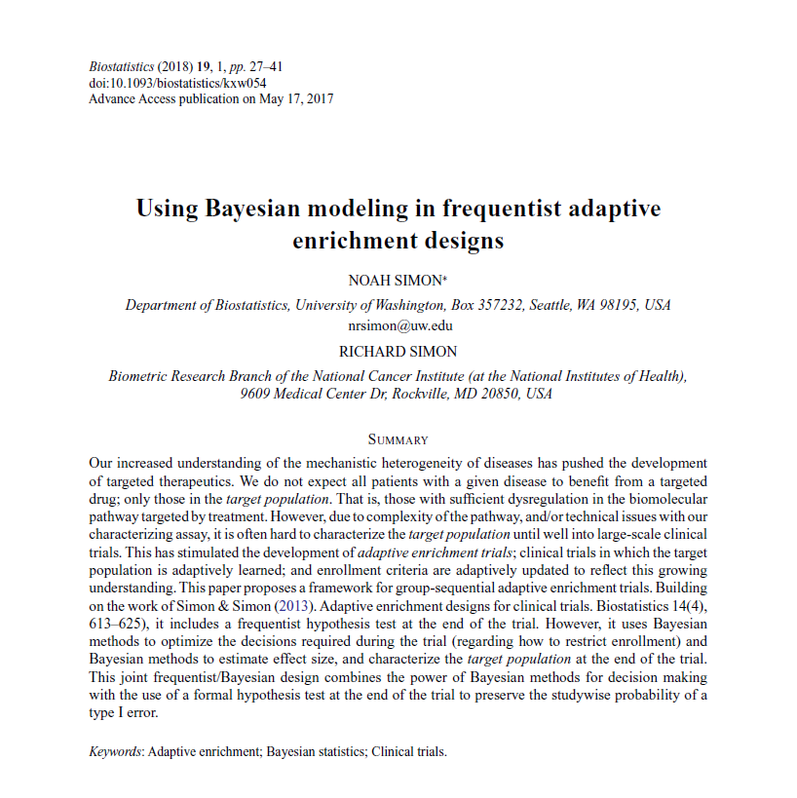

Slide 57
Two point parameter space
 | λ₊=0 | λ₊=λ*
λ₋=0 | α | (1-α)ϒ
λ₋=λ* | 0 | (1-α)(1-ϒ)

Slide 58
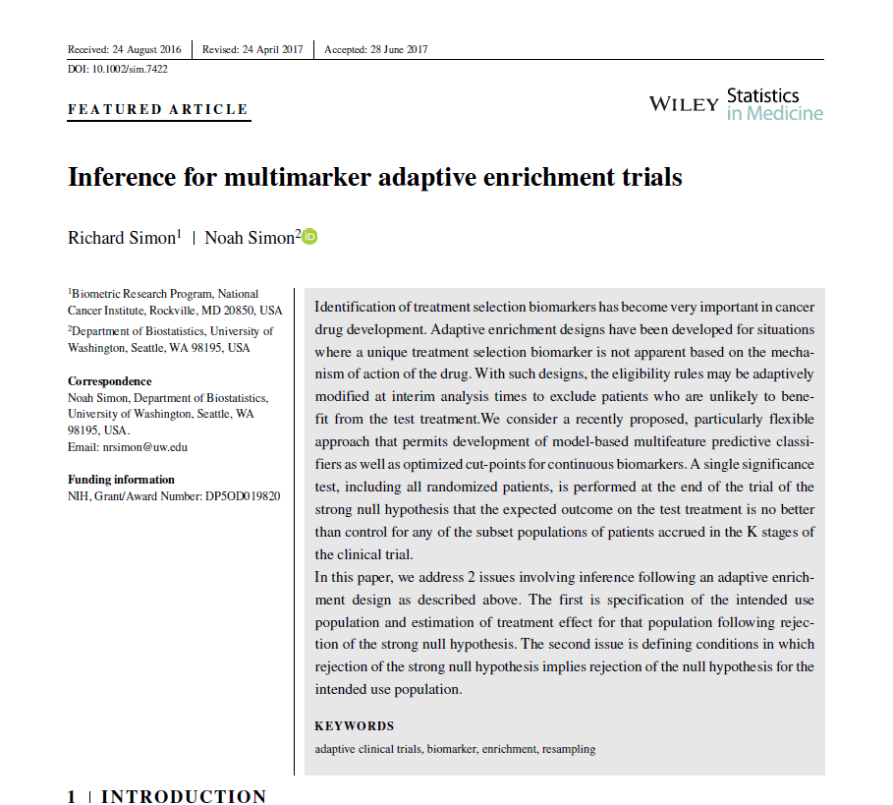

Slide 59
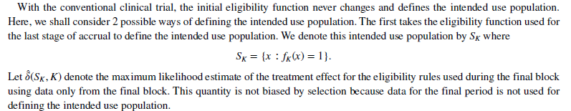

Slide 60
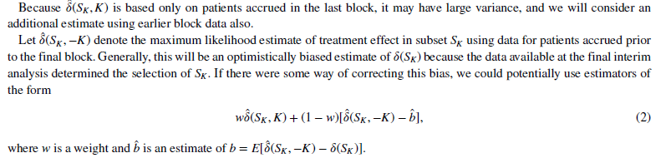

Slide 61
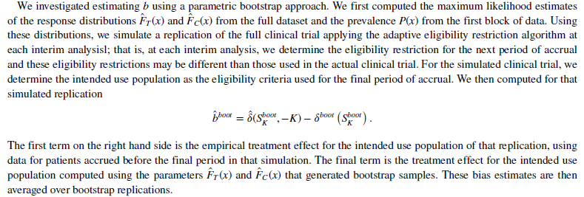

Slide 62
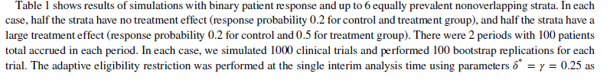
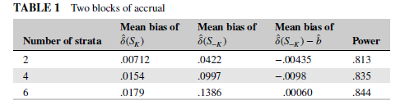
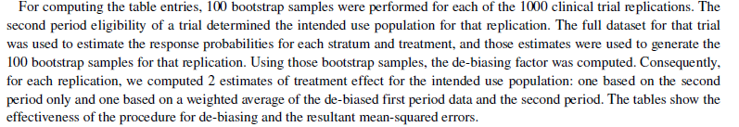

Slide 64
Adaptive Designs With
Single Binary Marker
Perform single interim analysis
If results are “not promising” for M- patients, then stop accrual of M- patients and continue accrual of M+ patients to their target sample size. At end test only H_{o+}
If results are “not promising” for M- patients or M+ patients, stop all accrual
Otherwise continue accrual of M- and M+ patients

Slide 65
Adaptive Threshold Enrichment
Randomize patients without regard to value of biomarker but measure biomarker pre-randomization on all patients
Pre-specify K candidate thresholds for the biomarker B₁,…,B_{K}

Slide 66
Adaptive Threshold Enrichment
Perform interim analysis using intermediate endpoint
Find largest candidate cut-point B_{k} such that
Pr[Δ(B) ≥Δ_{a}] < ε for B < B_{k}
where Δ_{a} is the treatment effect to be detected under the alternative hypothesis.
Continue accrual only for patients with B ≥ B_{k}

Slide 67
Simulation with Binary Response
p₀= response probability for control group
p₀= response probability for treatment group if B<b*
b*= true cut-point
p₁= response probability for treatment group if B≥b*
K=number of candidate cut-points
B is uniform on (0,1)
One interim analysis

Slide 68
p₀=.2, p₁=.5, K=5, N_{tot}=200, all pts 100/yr
True cut-point | Power adaptive | Power non-adaptive | Accrual adaptive | Accrual non-adaptive
.25 | .968 | .955 | 2.55 | 2.25
.5 | .897 | .726 | 3.19 | 3.25
.67 | .768 | .424 | 3.97 | 4.75
Two period cut-point enrichment
Response to T =p₁ if B≥cut-point
B uniform on (0,1)

Slide 69
Survival Data
Use intermediate endpoint for adapting eligibility
  PFS or response
z_{k}=standardized log-rank statistic for patients accrued in period k but evaluated at final analysis time

Slide 70
Simulations show that adaptive enrichment can substantially increase the statistical power with adaptive threshold determination and multi-biomarker modeling

Slide 71
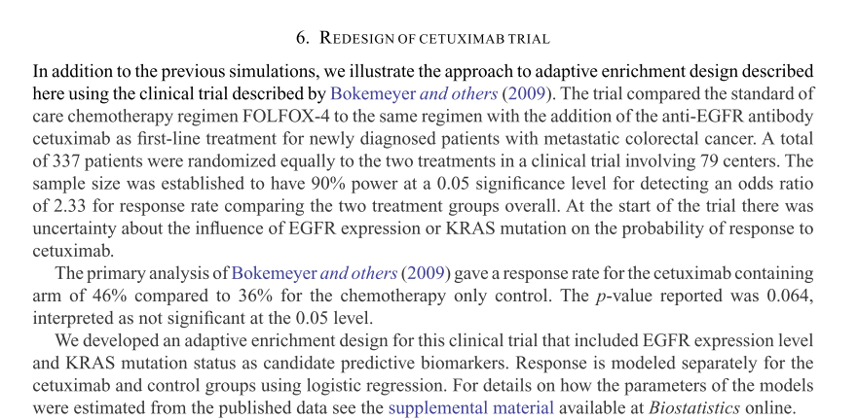

Slide 72
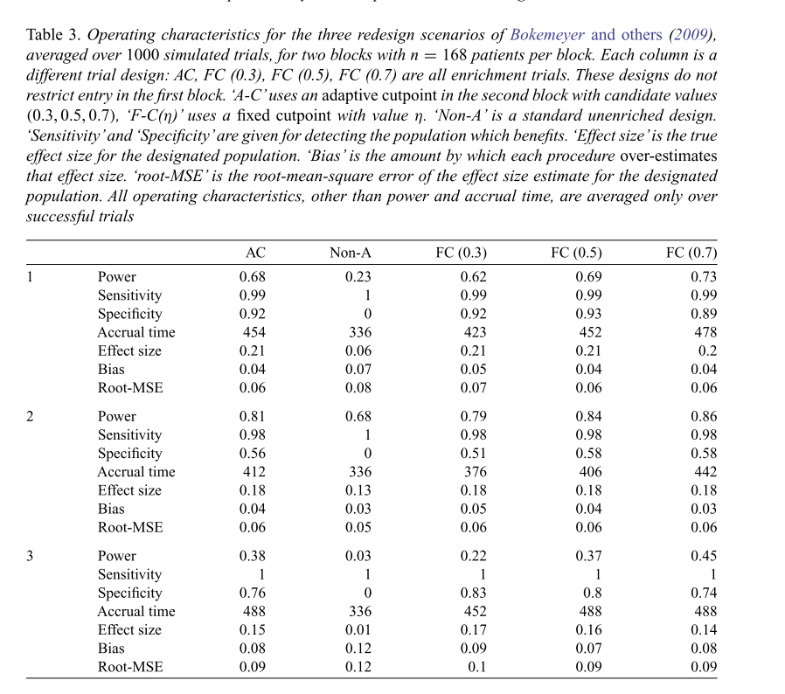

Slide 73
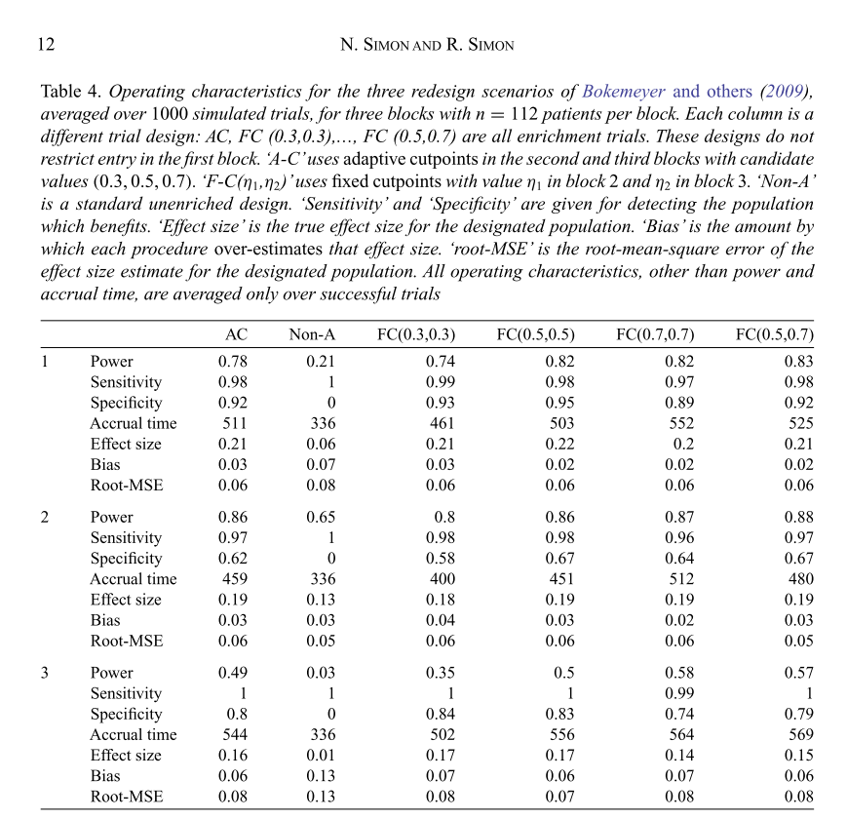

Slide 74
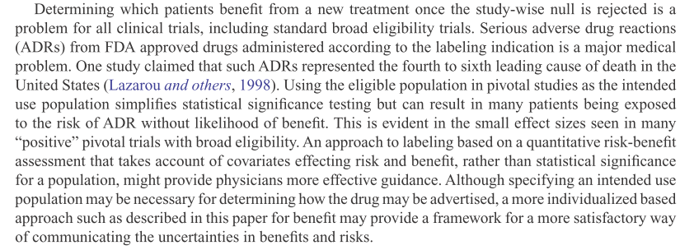

Slide 75
Acknowledgements
Noah Simon, U.W.
Boris Freidlin, NCI
Wenu Jiang, Queens U.
Abubakar Maitournam, Niger
Shigayaki Matsui, Nagoya U.

